Slide 1
Software Project Management
CSC 325
Lecture 1
<number> of 96
Notes:
January 4, 2017
Lecture 1
SE 477
<number> of 96

Slide 2
Surprise!
It's late Friday afternoon and you have just been told by your boss that you will be the project manager for a new software development project starting first thing on Monday morning. Congratulations!
Now, if only you had taken some project management training ...
<number> of 96
Notes:
January 4, 2017
Lecture 1
SE 477
<number> of 96

Slide 3
Course Objectives
Students will understand the motivation for, basic principles of, and terminology of project management.
Students will understand how development and project management concerns relate and how they may be integrated with one another.
Students will understand the activities and responsibilities of the project management team in a software development project.
Students will understand some of the reasons for IT project failures and how they might be averted.
Students will understand and carry out an essential subset of the activities associated with project planning, execution, monitoring and control, and close-out.
<number> of 96
Notes:
January 4, 2017
Lecture 1
SE 477
<number> of 96

Slide 4
Topics
Introduction and Overview: Software Process or What is a project? Project characteristics; Classic Mistakes;
Software project management overview: Project managers; Project organization; Putting a process in place; Software process; Phases for software project management; Defining the project; Project management tools
System Development Processes: SDLC; Agile Project Management; Project Planning – Initial Phase: The Project Management Plan; Scope Management; Creating the Work Breakdown Structure (WBS)
Project Planning: Activity Definition; WBS details; Activity Sequencing; Estimating size and complexity,
Project Planning: Activity Resource and Duration Estimating; Schedule Development: Scheduling: Gantt Chart and PERT and Critical Path Method (CPM); Schedule compression; Resource leveling; Mythical Man Month;
<number> of 96

Slide 5
Topics
Risk Management: Planning, risk identification, quantification and prioritization; Risk analysis, response planning, avoidance, mitigation, monitoring
Project Processes: Execution; Monitoring, control and tracking; Project velocity; Earned Value Analysis;
Miscellaneous: Quality Control, Planning and Assessment; Change control and project tracking; Final stages: Project Recovery; Project closeout; Project Success
Miscellaneous: Anti-patterns, Agile Project Management [if time allows]
Managing the Project Team: Project and Team Organization; Project Management Context; Managing the Project Team; Shaping project culture
January 4, 2017
SE 477: Lecture 1
<number> of 96

Slide 6
CSC 325 – Class 1
Topics: Introduction, Fundamentals, Classic Mistakes
Introduction
  Roadmap for Software Project Management
Fundamentals
  Software Process or What is a project?
  Project characteristics
Classic Mistakes
Reading:
  Reports on project failures – reasons and statistics
  The Project Office: Teams, Processes, and Tools, Gartner Research Strategic Analysis Report, Matt Light, 01 August
  See others in reading list.
  PMBOK-SWE Ch. 1
<number> of 96
Notes:
January 4, 2017
Lecture 1
SE 477
<number> of 96

Slide 7
Assignments
Assignment 1
Read the Gartner Report, From the CIO Trenches: Why Some Projects Fail and Others Succeed by David McClure (Gartner document ID: G00151721), available on the DePaul Libraries Web site. [See also D2L.]
<number> of 96
Notes:
PDF version of the Virtual Case File exists here <http://condor.depaul.edu/dmumaugh/readings/handouts/SE477/FBI-VCF.pdf>.
January 4, 2017
Lecture 1
SE 477
<number> of 96

Slide 8
Introduction
<number> of 96
Notes:
January 4, 2017
Lecture 1
SE 477
<number> of 96

Slide 9
What is a project?
What’s a project?
PMI definition
  A project is a temporary endeavor undertaken to create a unique product or service
OR: A sequence of connected and related activities (requirement engineering, system engineering, coding, testing, documentation, controlling, …) that must be completed by a specific time, within budget, and according to specification.
Progressively elaborated
  With repetitive elements
A project manager
  Analogy: conductor, coach, captain
<number> of 96
Notes:
Temporary:
can be years
Result can be lasting
Team can be temporary
Finite duration
Ex: thousands of buildings, but each is unique
Scope should be constant even as elaboration happens
January 4, 2017
Lecture 1
SE 477
<number> of 96

Slide 10
Project vs. Program Management
What’s a ‘program’?
Mostly differences of scale
Often a number of related projects
Longer than projects
Definitions vary
Example: Program Manager for MS Office
  Includes projects: Spelling, drawing, Word, Xcel, PowerPoint, etc.
<number> of 96
Notes:
January 4, 2017
Lecture 1
SE 477
<number> of 96

Slide 11
Project characteristics
A project is unique
  A Project creates unique deliverables: product, service, or result
  Even technically-identical projects are distinctly unique, due to internal or external contingent factors
Projects are temporary
  Every project has a deﬁnite beginning and a deﬁnite end
  Project end may be reached through success, qualiﬁed success, failure, or redundancy
  Projects need not be of short duration, but they are of ﬁnite duration
<number> of 96

Slide 12
Project characteristics
Projects have customer-speciﬁed performance criteria
  The customer deﬁnes these criteria in the form of requirements
  We will see that requirements are one of the most critical characteristics of a project that contributes to its success or failure
Projects consume resources
  Personnel resources
  Physical resources
  Monetary resources
<number> of 96

Slide 13
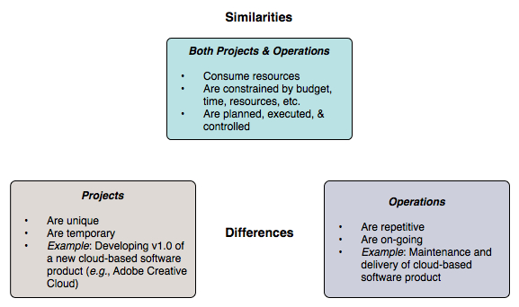
Projects vs. operations/production
<number> of 96

Slide 14
Characteristics of IT (Information Technology)
IT encompasses all forms of technology used to create, store, exchange, and use information in various forms
‘Information’ includes conventional data, voice, images, multimedia, etc.
Of central importance are computer, software, and communications technologies
Virtually all signiﬁcant projects are now distributed: networks of computers communicate only via message passing
Distribution poses additional challenges in IT projects: reliability, availability, security, and information synchronization
<number> of 96

Slide 15
How do IT projects differ from ‘ordinary’ projects?
IT products and services possess greater complexity
  IT products and services are intrinsically complex by nature
  Computing + communication + diverse data ⇒ complexity
IT projects have tight schedules
  Tight schedules are the norm in IT development
  Scheduling is aggravated by a pervasive ‘rush to market’ mentality
IT is an integral part of enterprise infrastructure
  IT is no longer an auxiliary element of the enterprise
  A business’ success is often critically dependent upon IT support
IT is permeated by quickly-changing technology
  Technology evolves (and may even become obsolete) during the lifetime of a major project
<number> of 96

Slide 16
Project characteristics
Four characteristics of projects:
  finite time
  people assigned
  clear roles and responsibilities
  things to deliver
Have you ever had this feeling about a project?
  not enough time
  too few people
  people not sure what they should be doing
  too much to do
<number> of 96
Notes:
January 4, 2017
Lecture 1
SE 477
<number> of 96

Slide 17
How Are Software Projects Different?
Consists of hardware and software.
Software is [usually] custom written and one-of-a-kind.
Hard to determine progress. [One can see how far a building project is progressing. One cannot see how far a piece of software has progressed]
Difficult to estimate schedule.
Difficult to determine cost.
<number> of 96
Notes:
January 4, 2017
Lecture 1
SE 477
<number> of 96

Slide 18
What is Project Management?
Project management is “the application of knowledge, skills, tools and techniques to project activities to meet project requirements” (PMBOK® Guide, Fifth Edition, 2013)
Software Project Management is the art to define, plan, execute, and monitor the activities that will bring software products to existence.
Project managers strive to meet the triple constraint by balancing project scope, time, and cost goals
<number> of 96
Notes:
January 4, 2017
Lecture 1
SE 477
<number> of 96

Slide 19
Project management processes
Regardless of the type of project lifecycle, project management encompasses the following process groups, shown with some representative tasks:
  Initiating/Define – Scope the project; Charter the project; identify stakeholders
  Planning – Develop the project plan. Collect requirements; identify schedule; plan scope, cost, quality, human resource, risk, and procurement management
  Executing – Launch the plan. Direct and manage project work; perform quality assurance; manage and develop project team; conduct procurements
  Monitoring and Controlling – Monitor project progress. Monitor and control project work; manage scope change; monitor and control schedule; control quality; control risks; control procurements
  Closing – Close out the project: Close project; close procurements
<number> of 96
Notes:
For some lifecycle types, some of the tasks are irrelevant or appear a radically different form; e.g., scope management in an adaptive (agile) lifecycle vs. predictive (conventional linear) lifecycle
January 4, 2017
Lecture 1
SE 477
<number> of 96

Slide 20
Software Project
Quality Engineering Principle:
The quality of the software system is controlled by the quality of the process used to produce that software.
Quality Management Principle:
Document the process
Measure the process
Improve the process based on the measurement
<number> of 96
Notes:
January 4, 2017
Lecture 1
SE 477
<number> of 96

Slide 21
Software Development Process
What is the software development process?
  A process is a set of documented procedures, methods, practices, and tools used to produce a software product.
The process will answer the following questions:
  What to do? Tasks/activities
  How to do it? Procedure/practice
  When to do it? Sequence of activities
  What are the artifacts? (input/output)
<number> of 96
Notes:
January 4, 2017
Lecture 1
SE 477
<number> of 96

Slide 22
Software Project
If the programmer and designer follow the process, then the artifacts they produce will be
  Predictable
  Based on the requirements
  Easy to maintain and control
  Consistent with the writing style
  Of acceptable quality
  Within acceptable milestones
By following the process, we will be able to know precisely what/how/when/where it happened !
<number> of 96
Notes:
January 4, 2017
Lecture 1
SE 477
<number> of 96

Slide 23
Software Processes
Software Process is an overloaded term
Metaprocess: an organization’s policies, procedures, and practices for pursuing a software-intensive line of business; the focus is on organizational economics, and long-term strategies.
Macroprocess: the project’s policies, procedures, and practices for producing a complete software product within certain cost, schedule, and quality constraints.
Microprocess: a project team’s policies, procedures, and practices for achieving an artifact of the software process.
<number> of 96
Notes:
January 4, 2017
Lecture 1
SE 477
<number> of 96

Slide 24
Core project management activities
Identify requirements
Address the various needs, concerns, and expectations of the stakeholders in the project
Establish active, effective, collaborative communications among the stakeholders
Manage stakeholders towards meeting project requirements and creating project deliverables
Balance the competing project constraints, including: scope, quality, schedule, budget, resources, and risks
Paraphrased from: A Guide to the Project Management Body of Knowledge (PMBOK® Guide)–Fifth Edition Project Management Institute, 2013.
<number> of 96
Notes:
SE 477
January 4, 2017
Lecture 1
<number> of 96

Slide 25
Software Project Trade-offs
What is the goal?
Balance the main three (other 2 constraints scope and resource) … in order to:
  Stay within the budget (cost)
  Deliver on time to gain market share (time)
  Exceed customer satisfaction (quality)
The time/scheduling hypocrisy
What can you tell me about the next project, you ask?
  It is due on June 1st tells your manager
We hold deadlines too dearly. Of course, time to market is critical
But what generally happens on projects when you hit that deadline?
<number> of 96
Notes:
January 4, 2017
Lecture 1
SE 477
<number> of 96

Slide 26
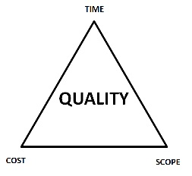
What makes a project successful?
Successful project management means meeting all three goals (scope, time, cost) – and satisfying the project’s sponsor.
Trade-off Triangle
Project constraints: Fast, cheap, good. Choose two.
Also stated as: “On-time, on-budget, high-quality. Choose two.”
  Reality often ignored in project planning
Know which of these are
fixed & variable for every project
  Time
  Cost
  Scope
January 4, 2017
SE 477: Lecture 1
<number> of 96
Notes:
January 4, 2017
Lecture 1
SE 477
<number> of 96

Slide 27
Success Metrics
On schedule
  Requires good: plan; estimation; control
Within budget
  Again: planning, estimation & control
According to requirements
  Importance of good requirements
  Perception & negotiation critical
High quality. May or may not be same as item 3
Only real measure:
  Is the customer happy?
  Customer satisfaction!!
<number> of 96
Notes:
January 4, 2017
Lecture 9
SE 477
<number> of 96

Slide 28
Factors in Project Success & Failure
<number> of 96
Notes:
SE 477
January 4, 2017
Lecture 1
<number> of 96

Slide 29
Software Crisis
Many software-related failures: auto-pilot systems, air traffic control systems, banking systems, IRS.
  On January 15, 1990, the AT&T long-distance telephone network broke down, interrupting long-distance telephone services in US for over 8 hours. [Missing break in a switch statement.]
  On June 4, 1996, the maiden flight of the new and improved Ariane 5 rocket exploded 37 seconds after lift-off.
  On June 8, 2001, a software problem caused the NYSE to shut down the entire trading floor for over an hour.
  Many, many, many more.
<number> of 96
Notes:
January 4, 2017
Lecture 1
SE 477
<number> of 96

Slide 30
What is the problem?
Software Projects have a terrible track record
A 1995 Standish Group study (CHAOS) [see notes] found that only 16.2% of IT projects were successful in meeting scope, time, and cost goals (on-time & on-budget) [Things have improved a bit since.]
Over 31% of IT projects were canceled [never seeing completion], costing over $81 billion in the U.S. alone
  They never worked
  Too late for the market window
Most projects are
  Late in delivery
  Missing functionality
  Have major defects (bugs)
  Did not do what the customer wanted
  Hard to maintain and support
<number> of 96
Notes:
According to the Standish Group ¹, in 1995, U.S. government and businesses spent approximately
$81 billion on canceled software projects, and another $59 billion for budget overruns. Their survey
claimed that in the United States, only about one-sixth of all projects were completed on time and within
budget, nearly one third of all projects were canceled outright, and well over half were considered
"challenged." Of the challenged or canceled projects, the average project was 189 percent over budget,
222 percent behind schedule, and contained only 61 percent of the originally specified features.
See the new paper: Phillip G. Armour, "Twenty Percent: Planning to fail on software projects", CACM,
Vol. 50, No. 6 (June 2007), p 21-23. (D2L > Documents)
The. Standish Group, "Chaos," 1995, http://www.standishgroup.com/chaos.html.
January 4, 2017
Lecture 1
SE 477
<number> of 96

Slide 31
The Standish Group’s CHAOS Report (2001)
Standish compiles and publishes a periodic survey on the success and failure rates of IT projects
These statistics date from 2001–however, based on more recent complementary reports, these numbers have remained fairly stable over the years:
  Average IT project schedule overrun: 163%
  Average IT project cost overrun: 145%
  Actual deliverable functionality compared to plan: 67%
  IT projects judged a success: 26%
  Lost value from marginal and failed projects: $75 billion
<number> of 96

Slide 32
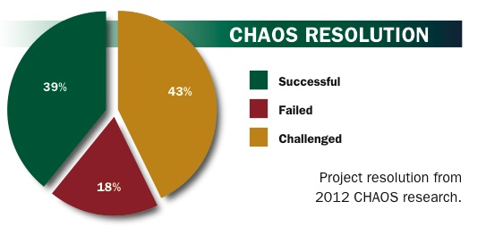
Chaos Report 2012
Project Success: Type 1. The project is completed on-time and on-budget, with all features and functions as initially specified. (2012: 39%)
Project Challenged: Type 2. The project is completed and operational but over-budget, over the time estimate, and offers fewer features and functions than originally specified. (2012: 43%)
Project Impaired: Type 3.
The project is canceled at some point
during the development cycle.
(2012: 18%) (Are ALL impaired
projects failures???)
<number> of 96
Notes:
January 4, 2017
Lecture 1
SE 477
<number> of 96

Slide 33
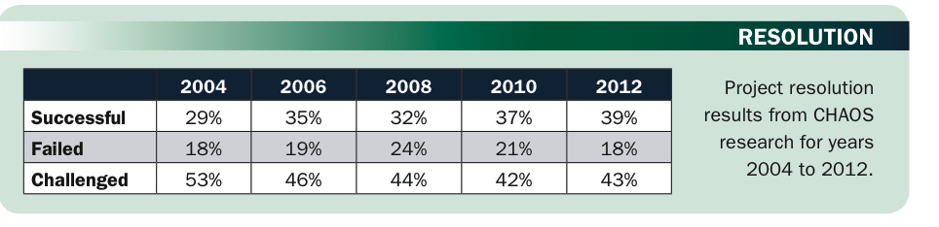
What Went Right? – Improved Project Performance
The Standish Group’s CHAOS studies show improvements in IT projects in the past decade
<number> of 96
Notes:
January 4, 2017
Lecture 1
SE 477
<number> of 96

Slide 34
Why the Improvements?
"The reasons for the increase in successful projects vary. First, the average cost of a project has been more than cut in half. Better tools have been created to monitor and control progress and better skilled project managers with better management processes are being used. The fact that there are processes is significant in itself.” *
*The Standish Group, "CHAOS 2001: A Recipe for Success" (2001).
<number> of 96
Notes:
January 4, 2017
Lecture 1
SE 477
<number> of 96

Slide 35

A Case Study
The Initial Launch of HealthCare.gov (2013)

Slide 36
ACA – HealthCare.gov
ACA signed into law on March 23, 2010
HealthCare.gov is a healthcare exchange website.
  “One-stop shopping sites for health insurance”
  CBO forecast: 7 million users during the first year
Development contracts awarded in September 2011
  No-bid, cost-plus contracts
  Pre-certified private contractors
HealthCare.gov launched on October 1, 2013
  Serious technological problems
<number> of 96

Slide 37
HealthCare.gov – The Launch Problems
Performance: response time (landing page) > 8s
  “Maddeningly long wait times"
Navigation: broken UI
Stability: intermittent crashes, availability ≈ 43%
Functionality: incorrect and incomplete data
Error rate (per page) ≈ 6%
Scalability: < 1,100 concurrent users
Enrollment completion rate < 30%
<number> of 96
Notes:
Error rate: time out or fail
<number> of 96

Slide 38
HealthCare.gov – The Contractors & The Cost
The lead contractor: CGI Group
  At least 47 private companies involved
  Including QSSI, Equifax, Serco
Coordinated by the Centers for Medicare and Medicaid Services (CMS)
Total budget: $293 million
  CGI: $196 million (2013). $112 million paid Oct. 2013
  QSSI: $85 million
Estimated actual cost: > $500 million by Oct. 2013
<number> of 96

Slide 39
HealthCare.gov – The Failures – Software Eng.
Inadequate Testing
  “This system just wasn't tested enough.” – CMS
  Full test began T -2 weeks (time before launch).
  Final “pre-flight checklist” T -1 week: 41 of 91 functions fail.
  No “end-to-end” test as late as T -4 days
  Stress tests T -1 day: performance degradation with only 1,100 concurrent users. (50,000-60,000 expected)
  Final top-to-bottom security tests not finished.
  No integration test. No beta test.
<number> of 96

Slide 40
HealthCare.gov – The Failures – Software Eng.
Evolving, Rolling Requirements
  Regulations and policies were still in flux when contracts awarded in 2011.
  The specifications for the project were delayed repeatedly.
  The regulations and policies were modified repeatedly until summer 2013.
  Repeated changes result in design changes.
  CGI did not start coding until Spring 2013
Failure to Effectively Manage Changes
  “Write-down-all-the-requirements-then-build-to-those-requirements”
  Did not adopt an agile development approach.
  Committed to an all-or-nothing launch date.
<number> of 96

Slide 41
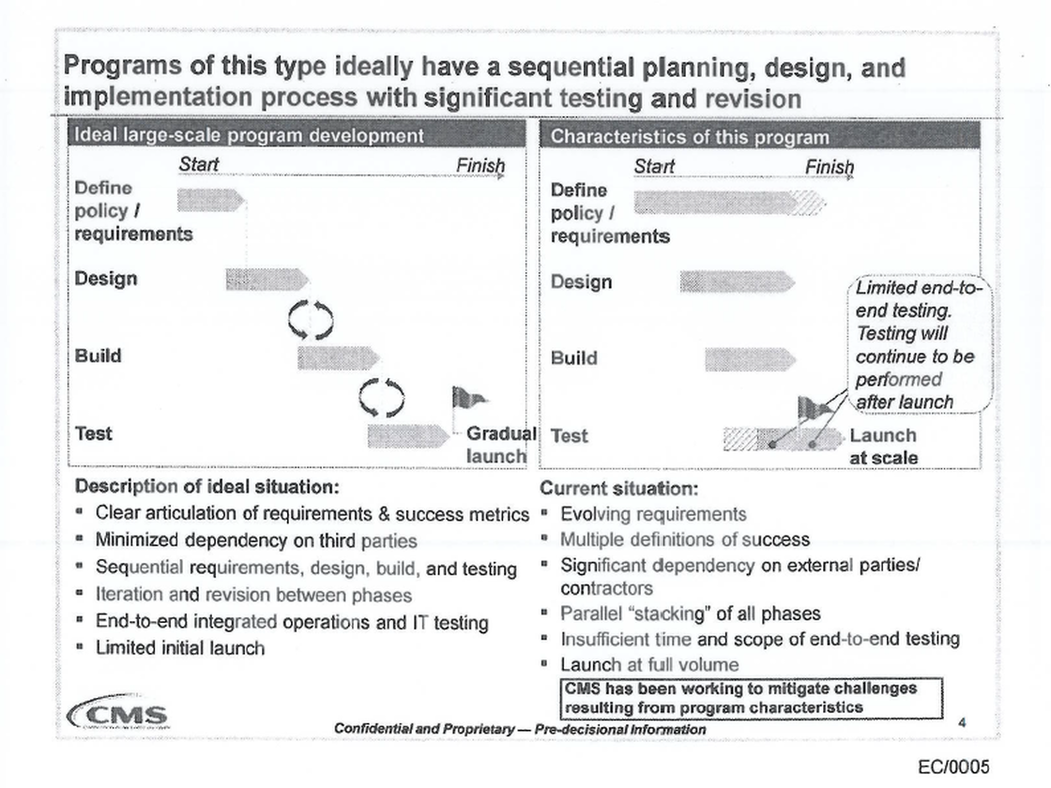
Case Study: HealthCare.gov– McKinsey “Red Team” Assessment
<number> of 96

Slide 42
Case Study: HealthCare.gov: The Failures – Management
Management expertise is in getting contracts not delivering projects.
Project quality is sacrificed for the sake of appearances.
Seriously substandard staffing and under staffing
  CGI. Three months before launch, only 10 developers were working on a crucial part of the site, and of those, only one was "at a high enough skill level.”
Lack of coordination among contractors
  Unclear responsibilities. Fragmented authority.
<number> of 96

Slide 43
Case Study: HealthCare.gov: The Failures – Gov. & Policies
Government IT projects
  Most are over budget and/or behind schedule.
  “Write-down-all-the-requirements-then-build-to-those-requirements” is outdated.
IT procurement policies
  Cost-plus contract, no-bid contracts
  “The firms that typically get contracts are the firms that are good at getting contracts, not typically good at executing on them.”
<number> of 96

Slide 44
Case Study: HealthCare.gov: The Lessons Learned
Adopt software engineering best practices
  Agile software development. Testing early.
  Software quality assurance and testing. Testing throughout.
Adopt management best practices
  Clear responsibility and accountability
  Performance metrics and progress tracking
Revamp government IT procurement policies
  Current system is antiquated, and has failed.
  Bring government IT to the 21th century.
<number> of 96

Slide 45
Case Study: HealthCare.Gov – Dec. 2013
400+ bug fixes, by the end of Nov. 2013
  “Operate smoothly for most users.” – W.H.
Availability > 90%
Response time (landing page) < 1s
Error rate (per page) < 1%
Completion rate ≈ 80%
System capacity ≈ 50,000 concurrent users
Sign-ups
  27,000 in Oct, 110,000 in Nov, 975,000 in Dec
<number> of 96

Slide 46
Case Study: HealthCare.Gov – April 2014
Issues on data accuracy and completeness
  Estimated 10-15% of sign-ups missing 834
  Other inaccuracies have been reported
CGI work during repair continue to be substandard
  Half of the software fixes failed. – CMS
CGI contract has been terminated. (Jan. 10, 2014)
March 31, 2014 (last day to sign up), site went down
April 1, 2014. 7.1 million signed up – W.H.
<number> of 96

Slide 47
Case Study: HealthCare.Gov – Aftermath
Accenture took over in Jan. 2014 as the lead contractor for development and maintenance: $175M
  Cost of building the system – GAO, July 2014
  $834M through Feb. 2014
    Total estimated cost: > $2B
  “CMS undertook the development of HealthCare.gov without effective planning or oversight practices”
  Also found “increased and unnecessary risk of unauthorized access, use, disclosure, modification or loss” of information
  CMS only withheld $267,000 in requested fees, 2% of the contract, from CGI.
<number> of 96

Slide 48
Case Study: HealthCare.Gov – 2015 Enrollment Cycle
Enrollment for 2015 (37 states)
  Nov 15, 2014 – February 15, 2015.
  Outages on the first day
  More smooth operation thereafter
February, 2015
  ~ 11.4 million sign-ups (~8.6 million re-enrollments)
    Open enrollment extensions: March 15 – April 30
  ~800,000 received incorrect tax information,
    Incorrect amount on 1095-A Form
<number> of 96

Slide 49
What is the problem?
Ever-Present Difficulties
Few guiding scientific principles
Few universally applicable methods
As much people problems as technological
  managerial / psychological / sociological
Sponsors unwilling to spend money for supposedly unrewarding activities
  Quality
Organizational rivalries
Time pressure
Cost pressure
<number> of 96
Notes:
January 4, 2017
Lecture 1
SE 477
<number> of 96

Slide 50
Why do IT projects fail?
Requirements, requirements, requirements
  Requirements are unclear, incomplete, or the project management methodology does not accommodate changing requirements effectively
Lack of user involvement
  A disengaged or absentee user (~customer) is an invitation for project problems or outright failure
  Often the result of a lack of business and IT integration
Unrealistic expectations (including unrealistic time frame expectations)
  Closely related to/result of ‘Lack of user involvement’
  “How hard can it be?” attitude of business and technical management
  Overly optimistic ‘can do’ attitude at all levels
  It is the project management team's responsibility to educate users in the realities of the project
<number> of 96
Notes:
January 4, 2017
Lecture 1
SE 477
<number> of 96

Slide 51
Why do IT projects fail?
Lack of planning
  You cannot achieve any goal without planning
  Proper approach to planning in a complex project must be adaptive: big planning up front is a waste of time and gives a false sense of security
  Related issues: Perceived rush to get started; overconﬁdence
Unclear (or lack of) vision and/or objectives
  The project vision must be established as one of the ﬁrst steps in project planning
  The vision for a project should be short, concise, and laser-sharp: the ‘elevator statement’ format is most effective
<number> of 96

Slide 52
Why do IT projects fail?
36 Classic Mistakes
AntiPatterns
Seductive Appeal: good reason for decisions at the time
Types
  People-Related
  Process-Related
  Product-Related
  Technology-Related
Gilligan’s Island
<number> of 96
Notes:
Seductive: good reason for decisions at the time
We’ll visit these throughout course
Gilligan’s Island: new scheme, get off island, seems to work, then fails
Being aware can help prevent
Class discussion
January 4, 2017
Lecture 1
SE 477
<number> of 96

Slide 53
People-Related Mistakes Part 1
Undermined motivation
Weak personnel
  Weak vs. Junior
Uncontrolled problem employees
Heroics
Adding people to a late project
Lack of match between people and needs
  Incompetent or over competent
  Culture clash
<number> of 96
Notes:
Motivation: studies show has largest impact
Don’t undermine Morale
2nd greatest influence on productivity
Junior != bad
Uncontrolled: most common developer complaint about their managers
Heroics. Company hostage.
“Can-do”, “how high” attitudes
Brooks, reading assignment
January 4, 2017
Lecture 1
SE 477
<number> of 96

Slide 54
People-Related Mistakes Part 2
Noisy, crowded offices
Customer-Developer friction
  Unrealistic expectations
  Lack of user input
Politics over substance
Lack of effective project sponsorship
Lack of stakeholder buy-in
Wishful thinking
<number> of 96
Notes:
60%of developers feel unsatisfactory environment: need quite and privacy
real offices
Friction: classic differing viewpoints
Results in ‘poor communication’
Passive-aggressive
User input: Survey: number 1 reason for success
W/O input: guessing
Realistic Expectations: 1 of top 5 reasons for success of in-house projects
Perception woe
Politics
Managing-up
Sponsor: a must, no power
All players must buy-in
Wishful
Cognitive dissonance
Closing your eyes and hoping
McConnell: maybe causes the most problems in software development
January 4, 2017
Lecture 1
SE 477
<number> of 96

Slide 55
Process-Related Mistakes Part 1
Optimistic schedules
  Omitting necessary tasks from estimates
  Planning to catch-up later
  Code-like-hell programming
  Insufficient risk management
Contractor failure
Insufficient planning
Abandonment of plan under pressure
<number> of 96
Notes:
Similar to wishful thinking
Puts unnecessary pressure
Missing tasks
Often 20-30% of a schedule
Catch-up later
How many times have you seen a project catch-up?
Only by all-nighters
Like hell
“Entrepreneurial” approach
Management controls
Need to be able to track
We’ll cover lots of these
PMI
See catch-up later
Risk Mgmt:
Risks will manage you
Contractor: late, poor quality, or fails to meet specifications
Requires lots of management
Insufficient planning: “if you don’t care where you’re going, any plan will do”
Abandonment
Out the window
Fall into code-and-fix mode
January 4, 2017
Lecture 1
SE 477
<number> of 96

Slide 56
Process-Related Mistakes Part 2
Wasted time during fuzzy front end
Shortchanged upstream activities
Inadequate design
Shortchanged quality assurance
Insufficient management controls
Frequent convergence
<number> of 96
Notes:
fuzzy: before sign-off
Upstream:
Lack of analysis and design
10 to 100 times more costly
5 hrs vs. 50
Design:
Seen schedules w/o it at all
QA:
Seems easy to compress
1 day QA == 3 to 10 later
Convergence
Waste of time
January 4, 2017
Lecture 1
SE 477
<number> of 96

Slide 57
Product-Related Mistakes
Requirements gold-plating
  Gilding the lily
Feature creep
Developer gold-plating
  Beware the pet project
Push-me, pull-me negotiation
  Slip schedule + add features
Research-oriented development
<number> of 96
Notes:
Gold
Gilding the lily
Performance is required more often than need be
Feature creep
25% average change in req.
Dev. Gold
Nifty new technology
Pet project
Push-me
Slip schedule + add features
Research vs. Development
January 4, 2017
Lecture 1
SE 477
<number> of 96

Slide 58
Technology-Related Mistakes
Silver-bullet syndrome
Overestimated savings from new tools and methods
  Fad warning
Switching tools in mid-project
Lack of automated source-code control
<number> of 96
Notes:
who’s heard of ‘silver bullet’ (not the beer)
Software savings on SCM
Jones: 10% month, I see more
January 4, 2017
Lecture 1
SE 477
<number> of 96

Slide 59
What Helps Projects Succeed?*
Executive support
User involvement
Experienced project manager
Clear business objectives
Minimized scope
Standard software infrastructure
Firm basic requirements
Formal methodology
Reliable estimates
Other criteria, such as small milestones, proper planning, competent staff, and ownership
*The Standish Group, “Extreme CHAOS,” (2001).
<number> of 96
Notes:
January 4, 2017
Lecture 1
SE 477
<number> of 96

Slide 60
Four Project Dimensions
Four Project Dimensions (The 4 P's)
People — the most important element of a successful project
Product — the software to be built
Process — the set of framework activities and software engineering tasks to get the job done
Project — all work required to make the product a reality
<number> of 96
Notes:
Peopleware issues
10-to-1 difference in Dev productivity
Teams 3 or 5 to 1 diff
Process
Dev basics, risk mgmt, QA, lifecycle planning, customer
orientation
Product
Most tangible dimension
January 4, 2017
Lecture 1
SE 477
<number> of 96

Slide 61
People
“It’s always a people problem”
– Gerald Weinberg, “The Secrets of Consulting”
Developer productivity: 10-to-1 range
  Teams 3 (or 5) to 1 difference
Improvements:
  Team selection
  Team organization
  Motivation
Other success factors
  Matching people to tasks
  Career development
  Balance: individual and team
  Clear communication
<number> of 96
Notes:
Teams: 5-to-1 range
January 4, 2017
Lecture 1
SE 477
<number> of 96

Slide 62
Process
Is process stifling?
  2 Types: Management & Technical
Development fundamentals
Quality assurance
Risk management
Lifecycle planning
Avoid abuse by neglect
Customer orientation
Process maturity improvement
Rework avoidance
Goals
  cut time-to-market
  Improve quality
<number> of 96
Notes:
cut time-to-market
Improve quality
January 4, 2017
Lecture 1
SE 477
<number> of 96

Slide 63
Product
The “tangible” dimension
Product size management
Product characteristics and requirements
Feature creep management
<number> of 96
Notes:
January 4, 2017
Lecture 1
SE 477
<number> of 96

Slide 64
Technology
Often the least important dimension
Language and tool selection
Value and cost of reuse
<number> of 96
Notes:
January 4, 2017
Lecture 1
SE 477
<number> of 96

Slide 65
Planning
Determine requirements
Determine resources
Select lifecycle model
Determine product features strategy
Tracking
  Cost, effort, schedule
  Planned vs. Actual
  How to handle when things go off plan?
<number> of 96
Notes:
January 4, 2017
Lecture 1
SE 477
<number> of 96

Slide 66
Measurements
To date and projected
  Cost
  Schedule
  Effort
  Product features
Alternatives
  Earned value analysis
  Defect rates
  Productivity (ex: SLOC)
  Complexity (ex: function points)
<number> of 96
Notes:
January 4, 2017
Lecture 1
SE 477
<number> of 96

Slide 67
Technical Fundamentals
Assumed Software Development Life Cycle (SDLC)
Requirements
Analysis
Design
Construction
Quality Assurance (aka Testing)
Deployment
<number> of 96
Notes:
January 4, 2017
Lecture 1
SE 477
<number> of 96

Slide 68
Software Project Management
Fundamentals
<number> of 96
Notes:
January 4, 2017
Lecture 1
SE 477
<number> of 96

Slide 69
Formal Project Management
Advantages of Using Formal Project Management
Better control of financial, physical, and human resources
Improved customer relations
Shorter development times
Lower costs
Higher quality and increased reliability
Higher profit margins
Improved productivity
Better internal coordination
Higher worker morale (less stress)
  Less “death marches”
  Less overworked personnel
<number> of 96
Notes:
January 4, 2017
Lecture 1
SE 477
<number> of 96

Slide 70
Getting organized
So, … now what?
Who is involved?
  Stakeholders
What do they want done?
  Charter, vision, requirements
Who do we have available to do the work?
  Resources and staffing
How do we do this?
  Project planning, WBS
How much will it cost
  Estimating
When will it be finished?
  Scheduling
What can possibly go wrong?
  Risk Management
<number> of 96
Notes:
January 4, 2017
Lecture 1
SE 477
<number> of 96

Slide 71
Summary of essential points
Projects and operations have both similarities and differences
Complex projects exhibit highly contingent behavior, are unpredictable, and face complex risks
Virtually all IT projects should be considered complex projects
Complex project management requires integration of signiﬁcant sociological, psychological, and technical skills
The factors contributing to project success and failure are reasonably well-known
This course discusses ways to achieve project success factors
<number> of 96
Notes:
SE 477
January 4, 2017
Lecture 1
<number> of 96

Slide 72
Next Class
Topic:
  Projects & System Development Life Cycles: Software project management overview and Project organization; Software process; Phases for software project management; Project management tools
Reading:
  Gartner Reports:
    Waterfalls, Products and Projects: A Primer to Software Development Methods by Matthew Hotle (Gartner document ID: G00155147)
    'Just Enough Process' for Applications by Matthew Hotle (Gartner document ID: G00145561)
  PMBOK-SWE Ch. 2;
  Scrum Primer (all)
<number> of 96
Notes:
January 4, 2017
Lecture 1
SE 477
<number> of 96

